Slide 1
Predictive Learning in the Dorsal Pathway: From Saccades to Navigation and Beyond
Randall C. O’Reilly
University of California Davis
eCortex, Inc

Slide 2
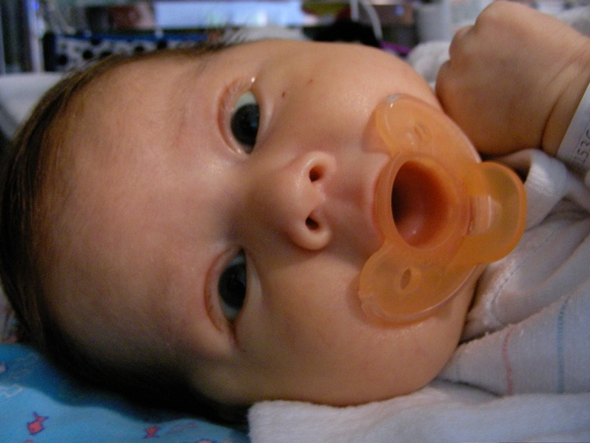
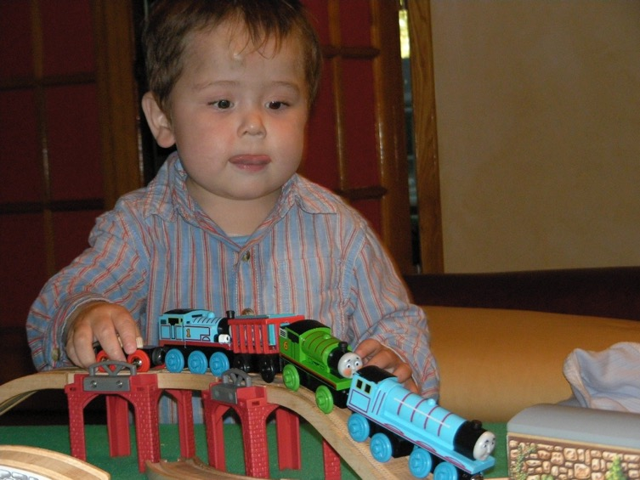
The Mystery of (Knowledge) Development
The first ~6 months: passive, but intent, staring at the world moving by..
And yet, so much is learned: the foundation for everything we know..
How does this happen!?

Slide 3
Three Levels
Computational level: error-driven & predictive learning
Implementational / biological level: thalamocortical loops
Functional / cognitive level: what can be learned?
Ventral pathway: object recognition
Dorsal pathway: saccades & navigation

Slide 4
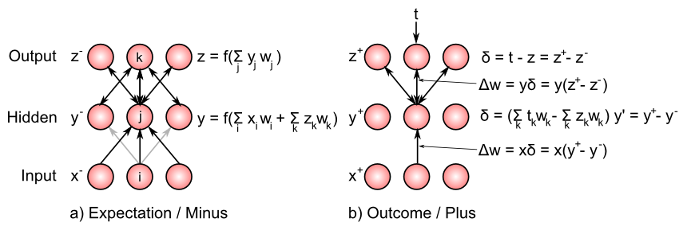
Bidirectional Connections Carry Error Gradients (GeneRec; O’Reilly, 1996)
dW = x⁺y⁺ - x⁻y⁻
(Midpoint integration + symmetry = Contrastive Hebbian = DBM)

Slide 5
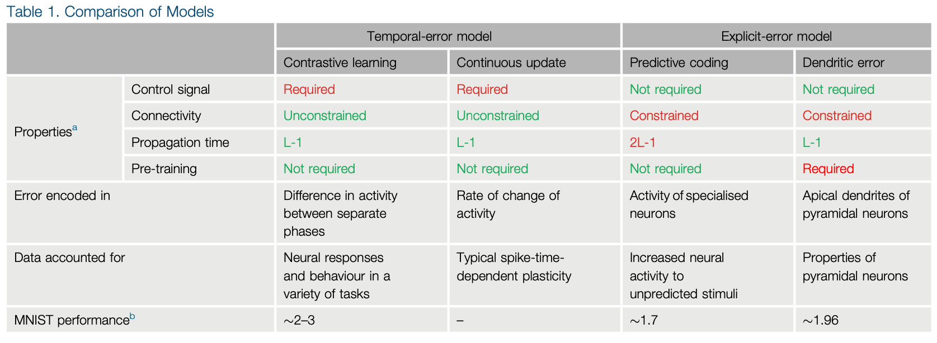
Many different approaches.. (Whittington & Bogacz Review, TICS, 2019)
Scellier, B. and Bengio, Y. (2017) Equivalence of equilibrium propagation and recurrent backpropagation. arXiv preprint arXiv:1711.08416
Lillicrap, T. P., Santoro, A., Marris, L., Akerman, C. J., & Hinton, G. (2020). Backpropagation and the brain. Nature Reviews Neuroscience, 21(6), 335–346.

Slide 6
Where do the targets & error signals come from?

Slide 7
Helmholtz: Recognition by Synthesis
Auto-encoders, Bayesian models, Rao & Ballard, Friston et al..

Slide 8
Key idea: We learn by constantly generating hypotheses or predictions about what will happen next!

Slide 9
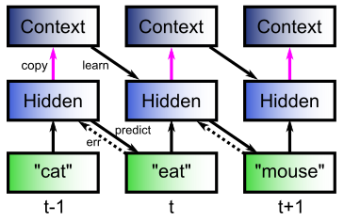
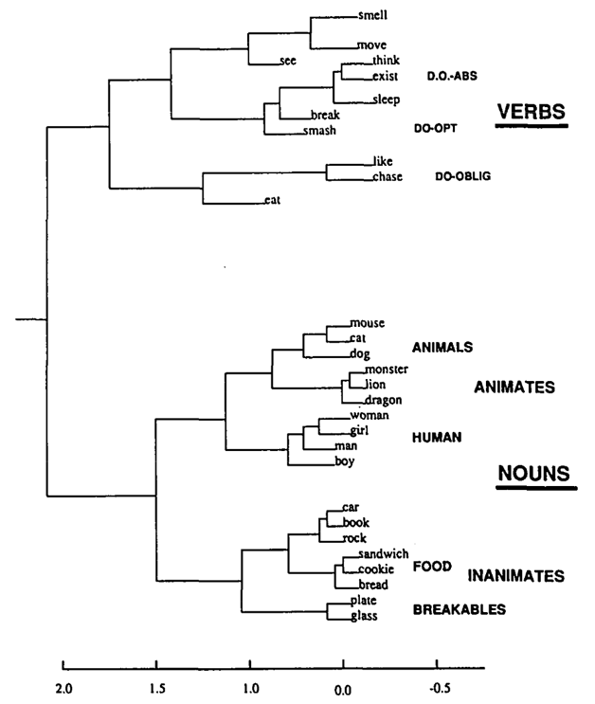
The Predictive Bootstrap (Elman 1990; Elman, Bates, et al. 1996)
Learning to predict words induces verb vs noun category representations in hidden layer of SRN
The future is free!
If you can predict it, you know it!

Slide 10
Biologically, how does it work?

Slide 11
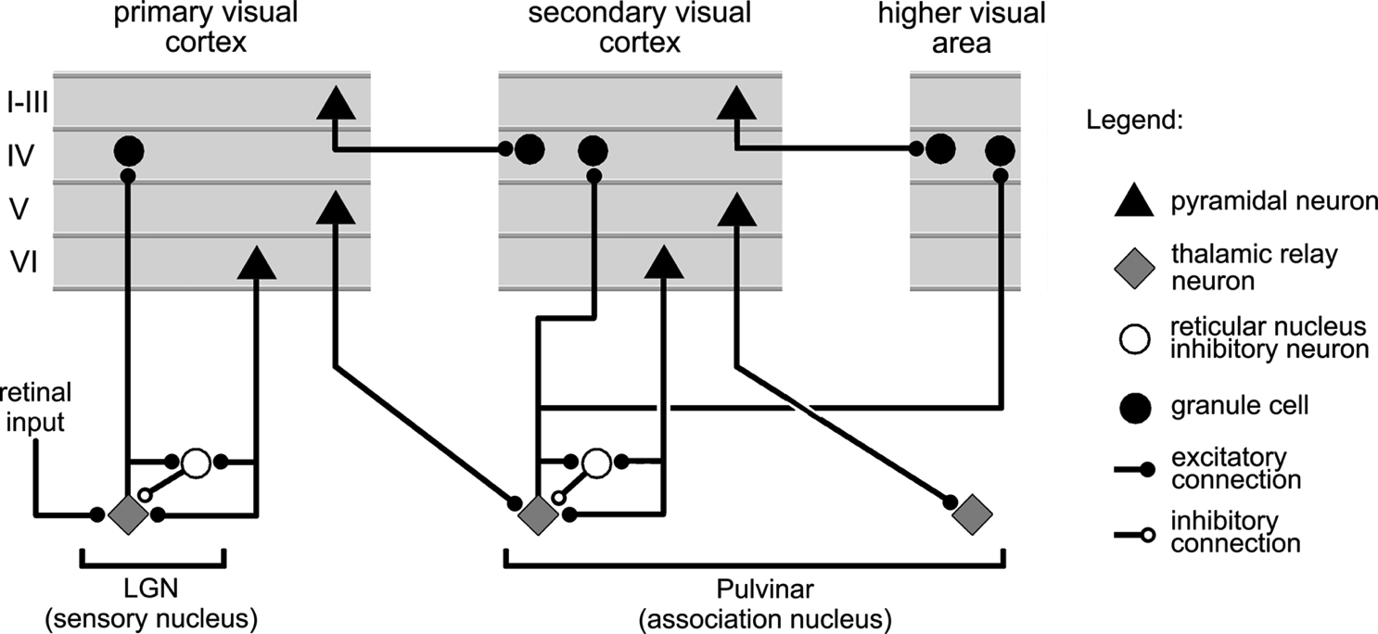
Thalamocortical Loop Biology (Sherman & Guillery, 2006)
5IB
FF
Driver
Weak
FB
“What happens”
Prediction

Slide 12
The Pulvinar = Projection Screen (c.f. Mumford, 1991 “blackboard”)
Pulvinar receives connections from all over visual cortex
and projects back out to these same areas
Two inputs:
1. Few strong feedforward:
“what happens”
2. Many weaker feedback:
prediction
Pulvinar!

Slide 13
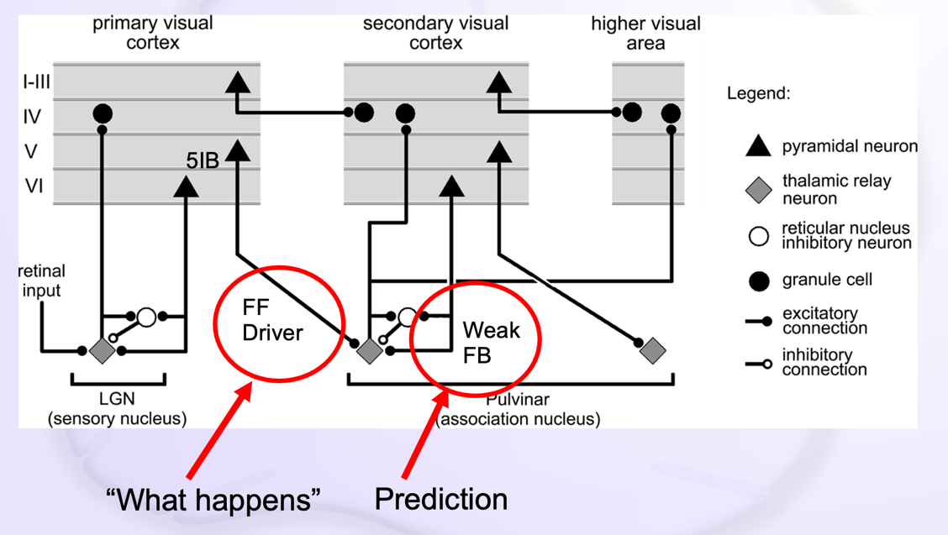
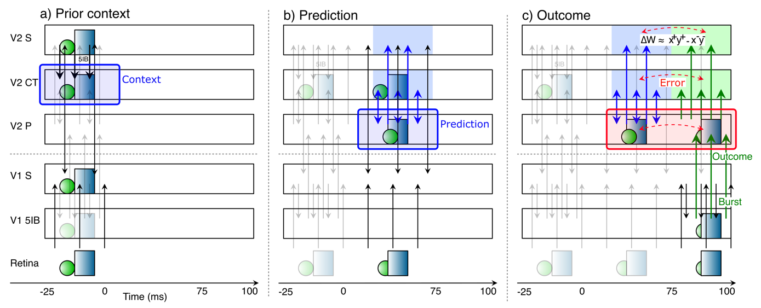
Deep Predictive Learning

Slide 14
Functionally: does it work?
Can merely predicting low-level sensory inputs produce higher-level abstract representations?
If not, maybe we still need a hand?

Slide 15
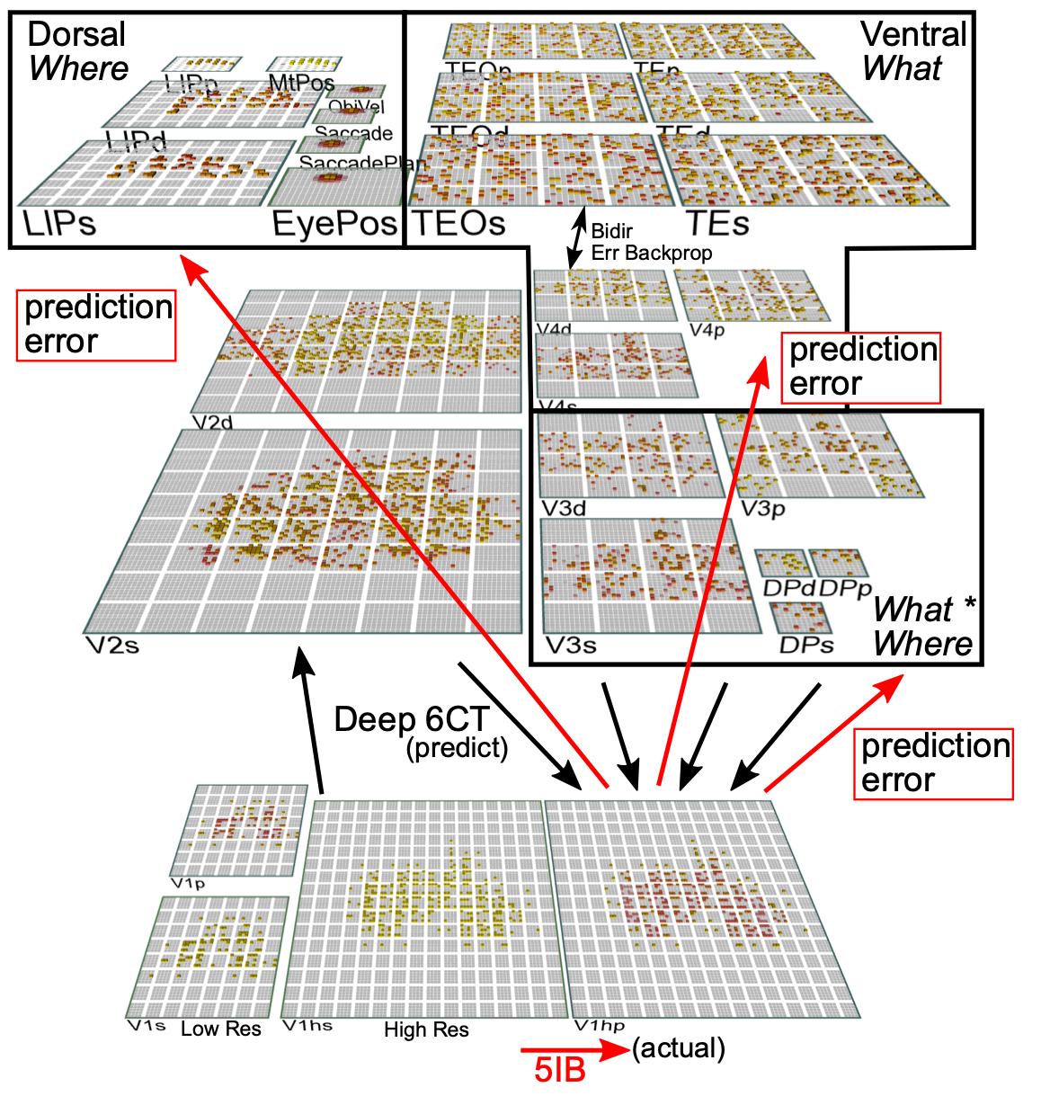
Ventral pathway: Object Recognition

Slide 16
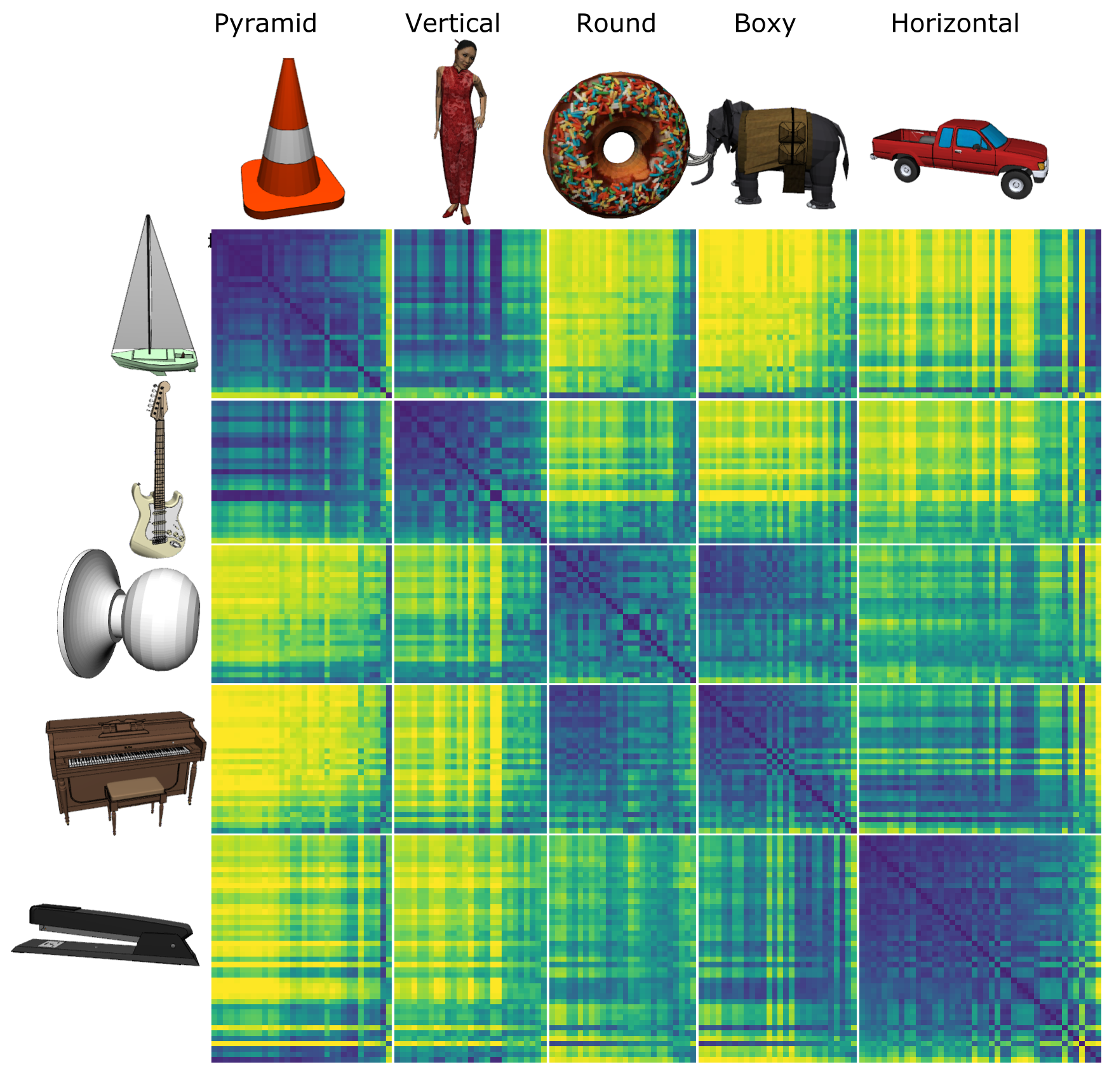
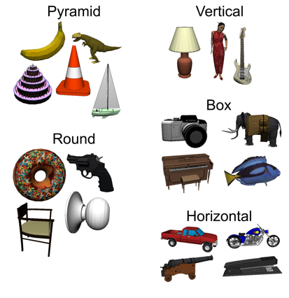
Model discovered
Shape categories!

Slide 17
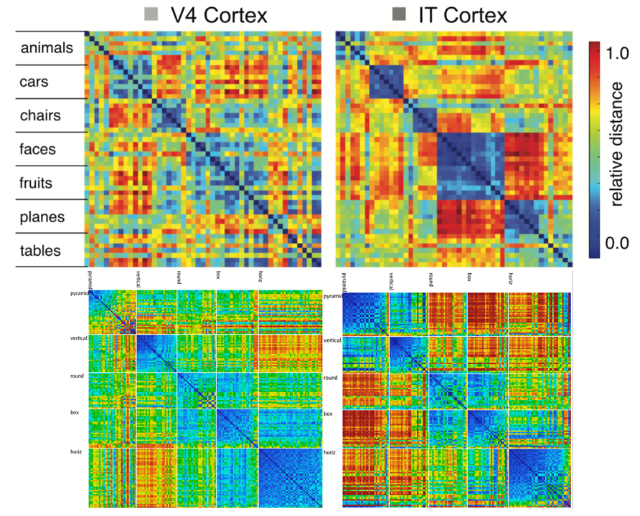
Model vs. Monkeys: Categories Emerge in Higher Layers

Slide 18
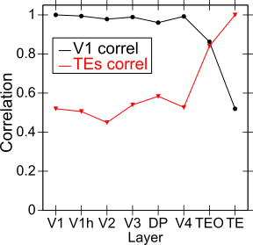
Categories not in V1; Emerge in IT Obj Rec Pathway

Slide 19
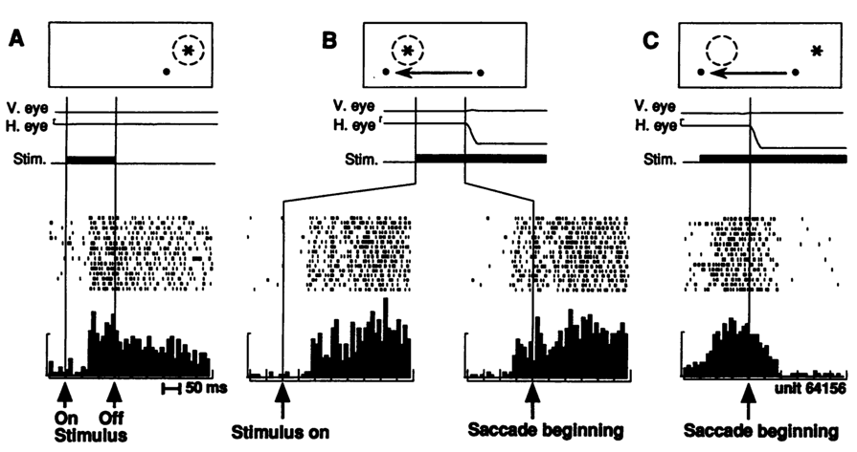
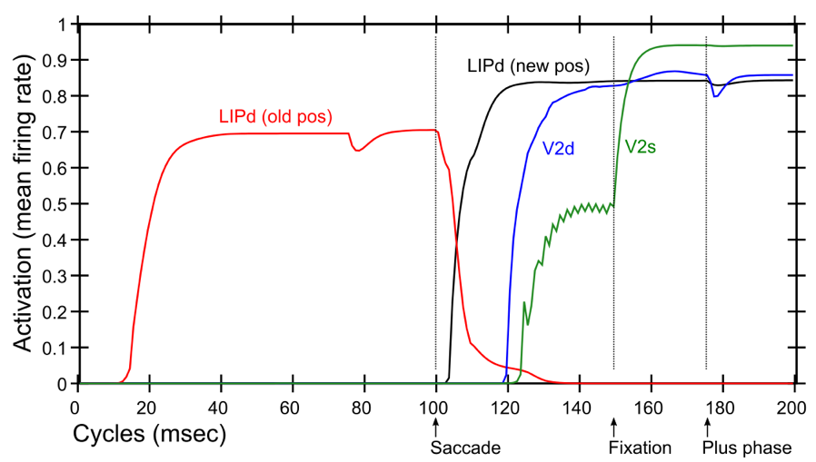
Dorsal Pathway & Saccades: Predictive Remapping
Duhamel et al. (1992):
LIP neurons anticipate effect of saccade, start firing for new location before fixation lands (even before saccade)
Model:
LIPd remaps first at high, abstract level, drives top-down remapping in lower areas – consistent with Cavanagh et al. (2010)

Slide 20
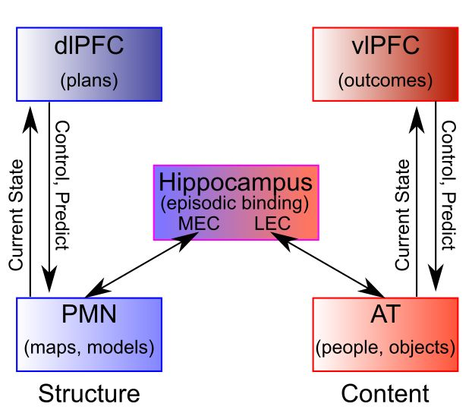
Predictive Learning in Navigation: Distributed, Coordinated Networks
Ranganath & Ritchey, 2012

Slide 21
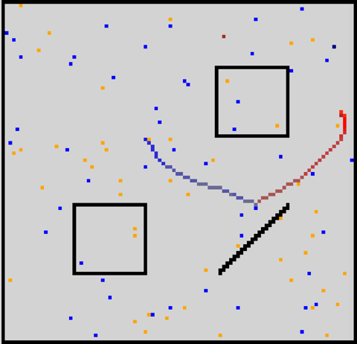
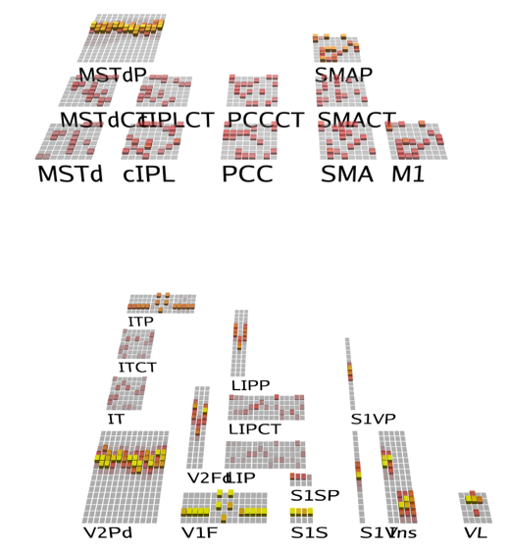
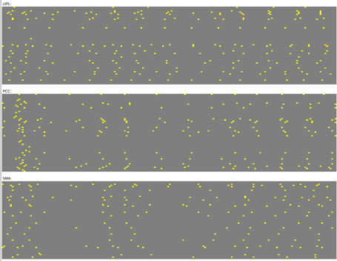
Spiking Predictive Learning Model
Multimodal sensory prediction: full field depth, foveal vision, somatosensory (whiskers, vestibular), body state (thirst, hunger)
Error-driven predictive learning based on action: predict next state
New fully spiking error-driven learning (bio backprop) model!

Slide 22
Spiking Predictive Learning Model
Navigation through prediction: no explicit allocentric map, just enough context to disambiguate predictions at different locations!
Parietal lobe learns structural representations of state-transitions caused by actions.

Slide 23
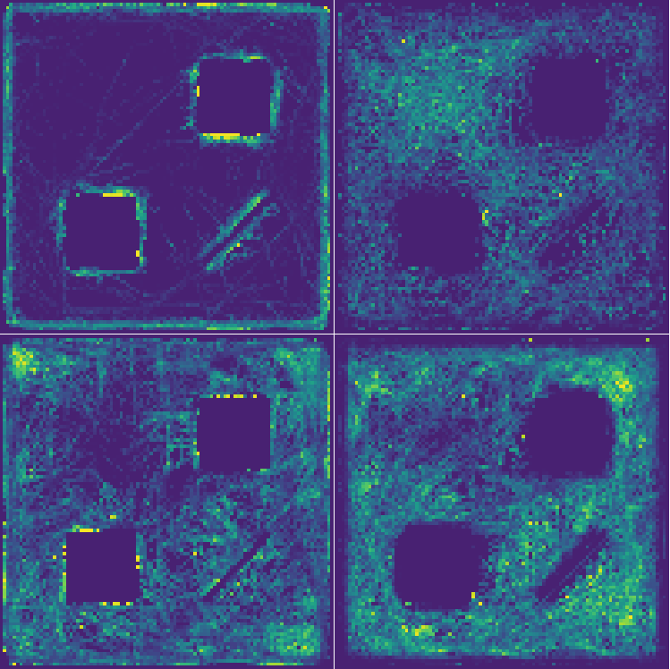
Learned Receptive Fields
Border cells, corner cells, multiple resolution..
Work-in-progress: too dominated by high-frequency cases..

Slide 24

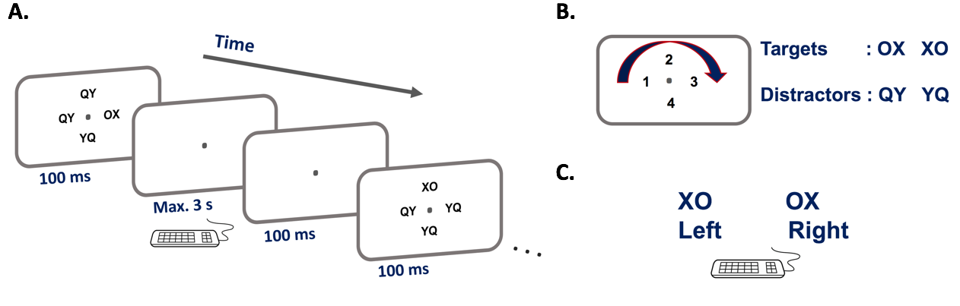
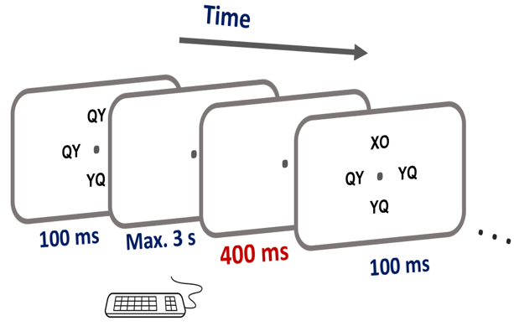
Experimental Test
Maryam Zolfaghar
Seq 1: 42132431
Seq 2: 13423124
Progression of early pre-stimulus activity pattern similar to post-stimulus

Slide 25

Speech Perception
John Rohrlich applying model to statistical learning in speech, using full auditory input.
Starting with Graf-Estes & Lew-Williams 2015 stimuli based on Saffran et al paradigm.
Shows reliable effects for reliable vs. unreliable sequences.

Slide 26
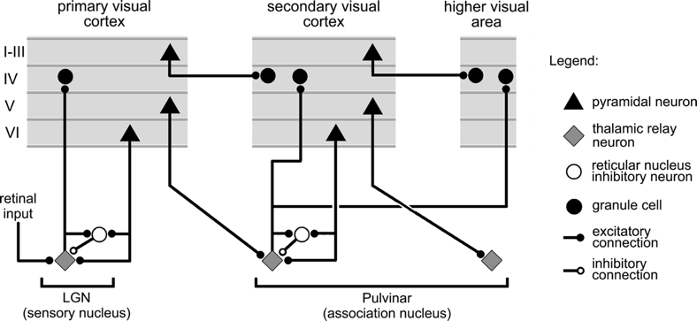
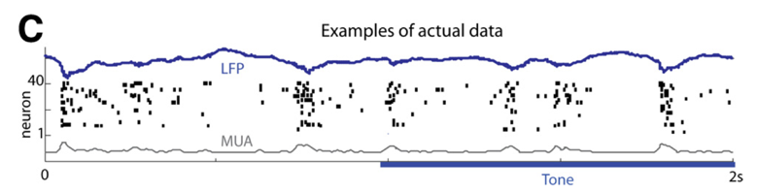
Key Biological Data
Strong, synchronized, low-frequency modulation of cortex (at the alpha frequency).
Specificity of alpha modulation to deep layers & thalamus, not superficial layers.
Nature of deep-layer connectivity to pulvinar: numerous, weaker, plastic pathway (for generating a prediction) and sparse, strong, fixed pathway (for ground truth target).
Synchronization of this strong pathway input with the alpha cycle.
Broad connectivity of pulvinar with different visual pathways (afferent and efferent).
Lack of direct bottom-up superficial projections into the deep layers (would short-circuit prediction), but presence of these projections top-down (beneficial).
Bidirectional (top-down and bottom-up) connectivity between superficial layers.
Early development of the Where (MT, LIP) pathway.
Organization into three separable (yet highly interconnected) visual pathways, particularly a third putative What*Where integration pathway.
(Buffalo et al., 2011; van Kerkoerle et al., 2014; Shipp, 2003; VanRullen & Koch, 2003; Luczak et al., 2013..)

Slide 27
Conclusions
Peculiar features of connectivity between cortex and thalamus support a form of predictive learning.
Builds on temporal-difference error-driven learning mechanism.
Ventral visual stream model: predictive learning from raw visual “movies” self-organizes abstract categorical object representations (based on shape, not texture!)
Dorsal visual stream models: predictive coding in saccades, and coordinated processing across multiple areas to support navigation and strategic, goal-driven behavior.

Slide 28
Thanks To
CCN Lab
Andrew Carlson
Riley DeHaan
Tom Hazy
Seth Herd
Kai Krueger
April Luo
Jessica Mollick
Ananta Nair
John Rohrlich
Jake Russin
Maryam Zolfaghar
Funding
ONR – Hawkins & McKenna
Collaborators
Charan Ranganath (Davis)
Erie Boorman (Davis)
Ignacio Saez (Davis)
Jonathan Cohen (Princeton)

Slide 29
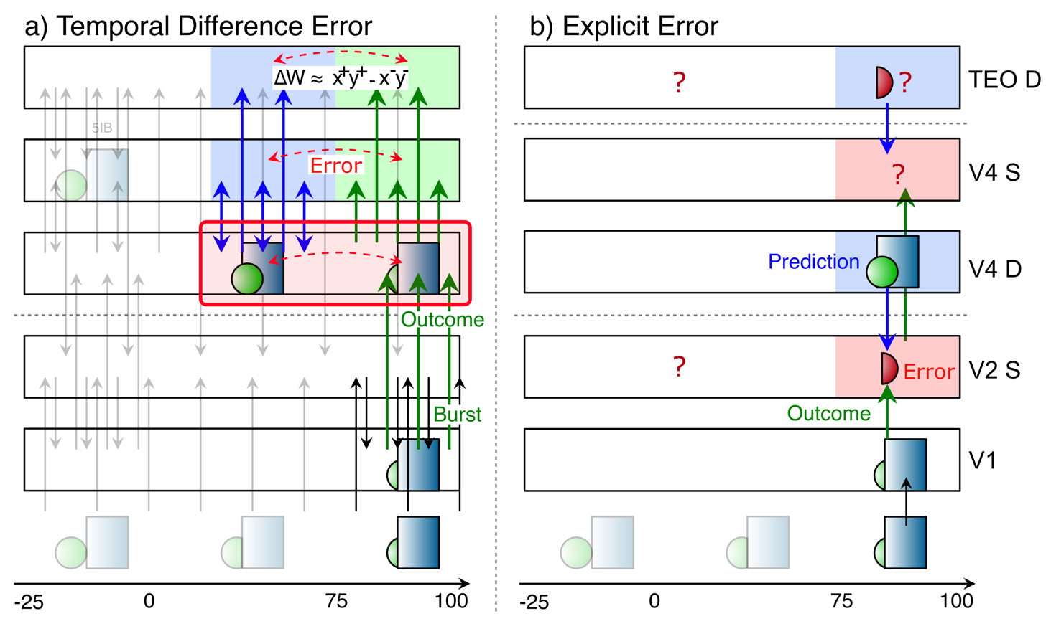
Key Diffs From Friston / Bayes

Slide 30
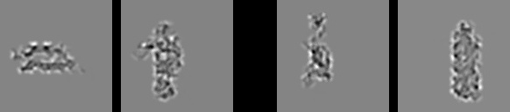
Model vs. Humans
Which pair is more similar in terms of overall shape?

Slide 31

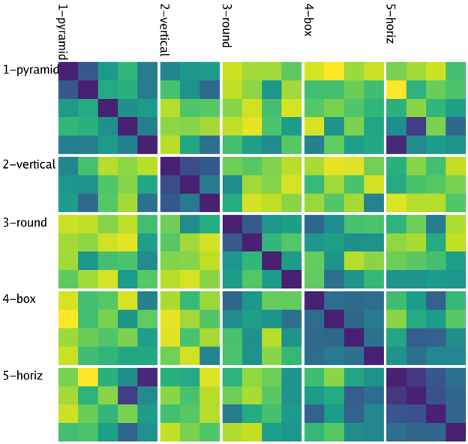
Model
People

Slide 32
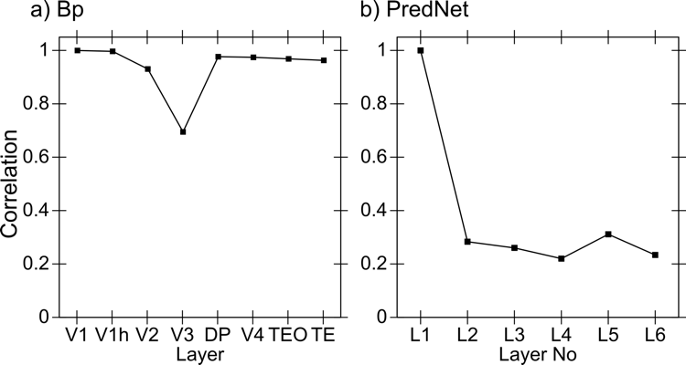
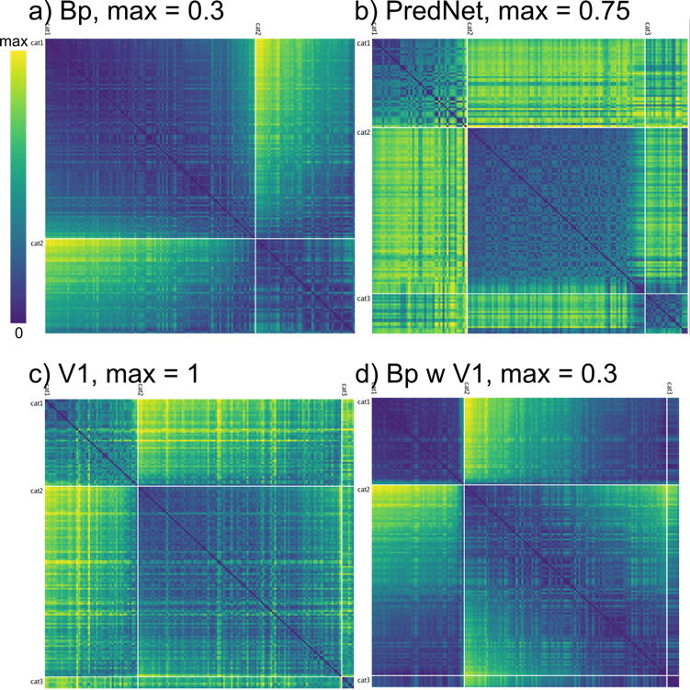
Backprop Comparison Models
No progressive formation of abstract categories -- low dimensional, V1-like representations even in highest layers
Diffs: Bidirectional connectivity, inhibitory competition, small amounts of Hebbian learning..

Slide 33
“Standard” approach (Friston et al)
Explicit error-coding neurons subtracting top-down vs. bottom up
But: no evidence of such cells!

Slide 34
Hebbian is too Dumb!
Babies exhibit some serious active, theory-like learning abilities!
Not just passive soaking up of statistics..

Slide 35
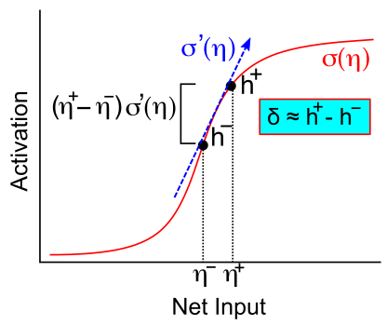
Activation Diffs Implicitly Compute Derivatives (GeneRec; O’Reilly, 1996)
Free to use arbitrarily complex activation functions!

Slide 36
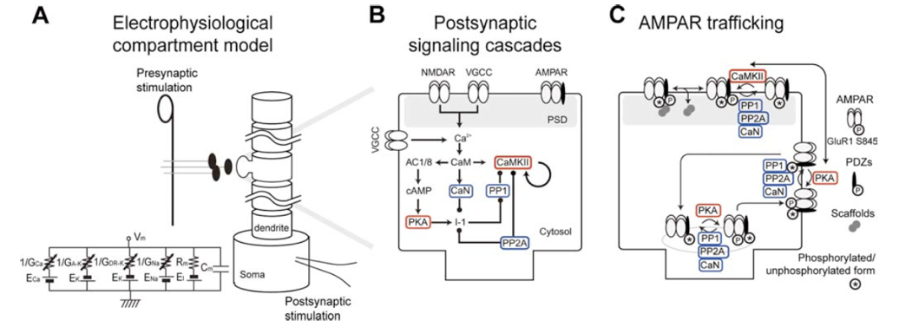
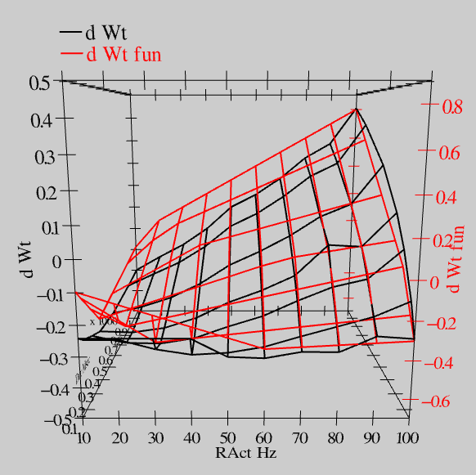
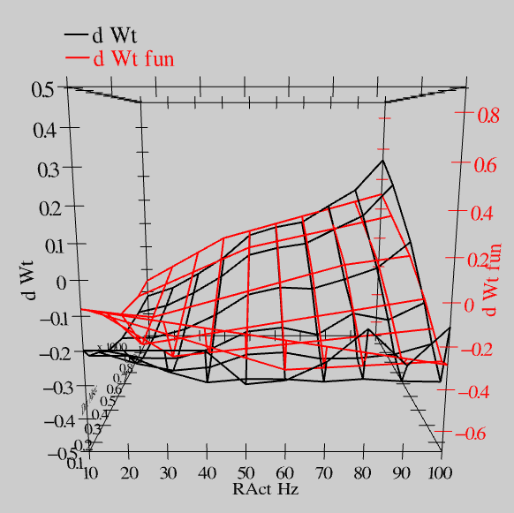
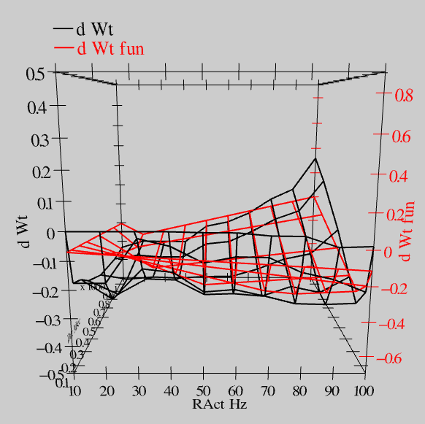
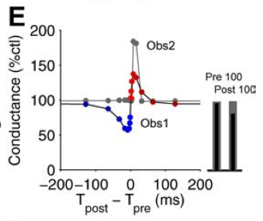
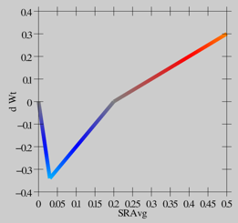
Synaptic Plasticity: XCAL Model (reduction of Urakubo et al, 2008 STDP model)
S = 100Hz
S = 50Hz
S = 20Hz
dW = f(send * recv) =
(spike rate * duration)
r=.894

Slide 37
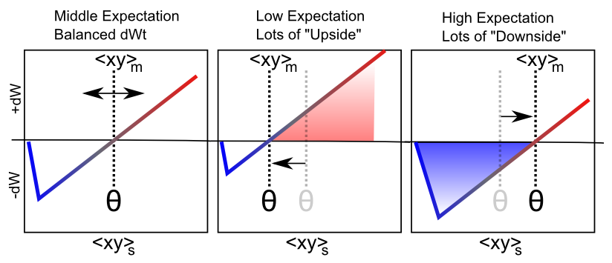
Floating Threshold = Medium Term Synaptic Activity (Error-Driven)
dW = Outcome – Expectation = <xy>_{s} - <xy>_{m}

Slide 38
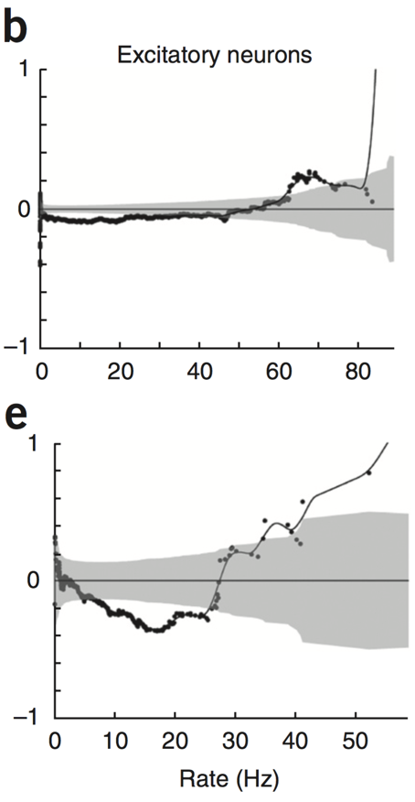
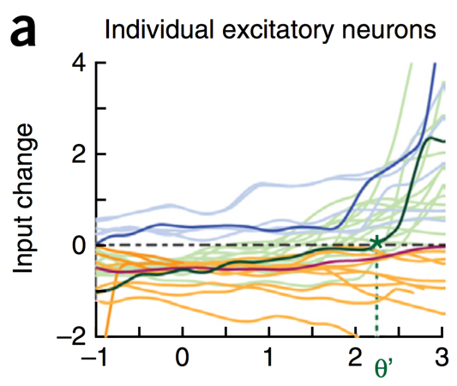
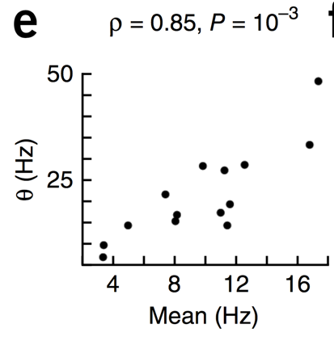
Evidence of Dynamic Thresholds (Lim, McKee, Woloszyn et al., 2015)
b = passive viewing
e = active task
Threshold changes dynamically on a rapid time scale, as a function of short-term activity level!

Slide 39
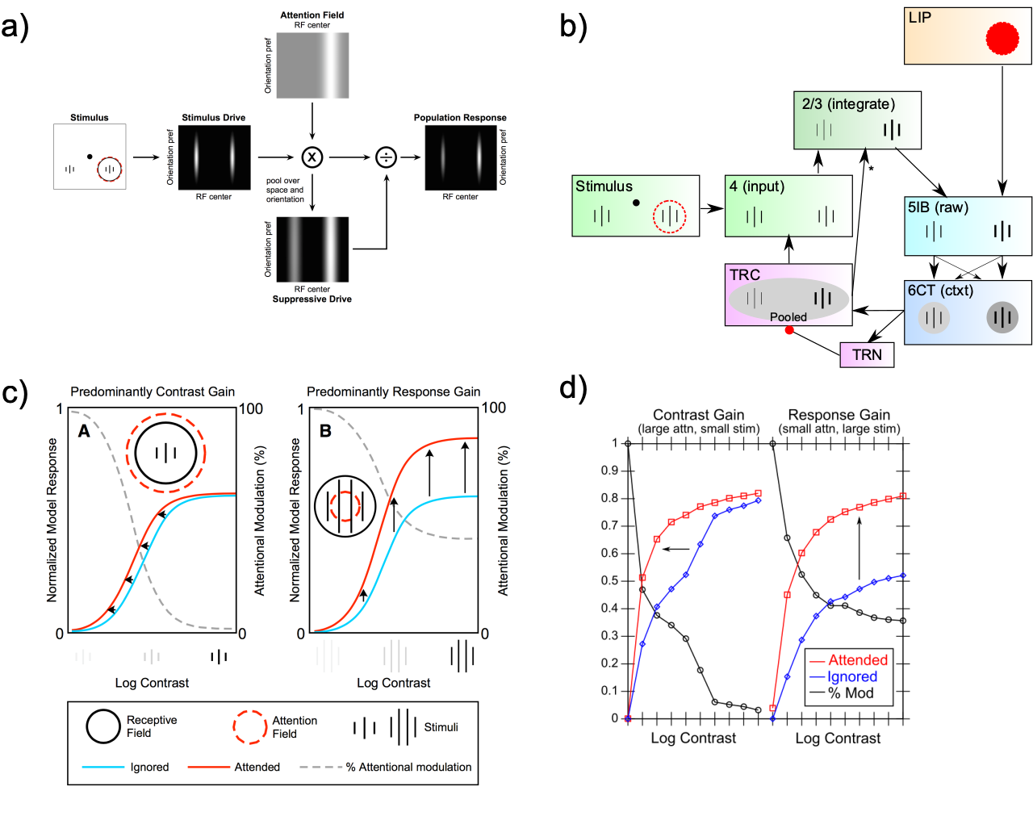
Deep Attentional Dynamics (Reynolds & Heeger, 2009; Grossberg, 1999)

